Slide 1

Unit-2 Routing, Versioning in Web API & Fluent Validations
Advanced Dot Net
#2101CS611
Prof. Naimish R. Vadodariya
Computer Science & Engineering Department
Naimish.vadodariya@darshan.ac.in
8866215253

Slide 2

Looping
Outline
API Versioning
Types of API Versioning
Routing introduction
Variables and Query Strings
Route Constraints
Fluent API Validations
Advantages of Fluent Validation

Slide 3
API Versioning
Section - 1

Slide 4
Intro: API Versioning
In the ever-changing business world, the only constant is ‘change’.
In the custom software development business, the change is implemented by versioning.
Versioning is a process of adding improvements in an existing model while keeping the current model too and essentially selling both the products differently at different prices.
Improving the functioning of the application developed has its vision associated with increasing overall productivity and efficiency of the developed application.
In ASP.NET Core technology API versioning allows users to create an API without affecting the previous set of users, adding some new APIs on top of existing ones.
Let’s start with how to set up for new web API versioning.

Slide 5
What is API Versioning?
API versioning is the process of managing and tracking changes to an API.
It also involves communicating those changes to the API's consumers.
Sometimes, developers have to update their API's code to fix security vulnerabilities, while other changes introduce new features or functionality.
Some changes do not affect consumers at all, while others, which are known as “breaking changes” lead to backward-compatibility issues, such as unexpected errors and data corruption.
API versioning ensures that these changes are rolled out successfully in order to preserve consumer trust while keeping the API secure, bug-free, and highly performant.
So, creating an API that has multiple versions that can behave differently is essential.
By following this approach, the client requirement may change with time but there is no compromise seen when it comes to the availability and integrity of the data for the existing client apps.

Slide 6
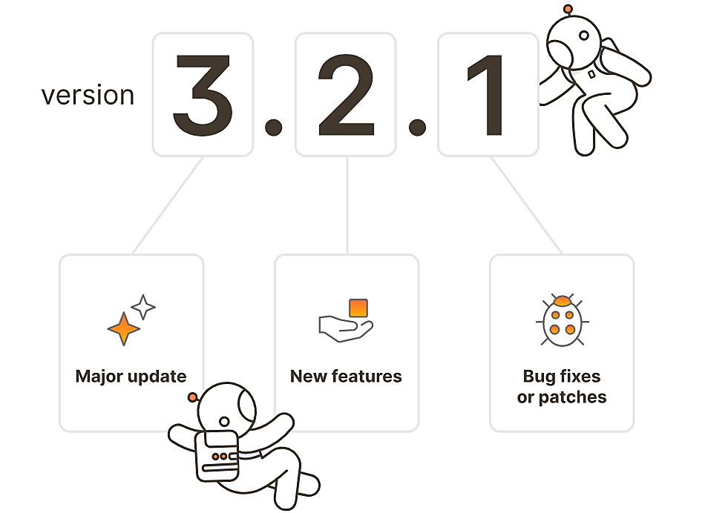
What is API Versioning? Cont..

Slide 7
Types of API Versioning
URL Versioning
With this approach, the version number is included in the URL of the API endpoint.
For instance, consumers who are interested in viewing all of the products in a database would send a request to the https://example-api.com/v1/products endpoint.
This is the most popular type of API versioning.
Query Parameter Versioning
This strategy requires users to include the version number as a query parameter in the API request.
For instance, they might send a request to https://example-api.com/products?version=v1.
Header Versioning
This approach allows consumers to pass the version number as a header in the API request, which decouples the API version from the URL structure.
Consumer-based Versioning
This versioning strategy allows consumers to choose the appropriate version based on their needs.
With this approach, the version that exists at the time of the consumer's first call is stored with the consumer's information.
Every future call is then executed against this same version-unless the consumer explicitly modifies their configuration.

Slide 8
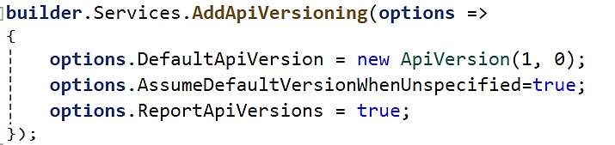
How to do Versioning in .NET Core Web API?
Start with the Installation of the Versioning Nuget package from Nuget Package Manager or Package Manager Console in the API project as shown below
Microsoft.AspNetCore.Mvc.Versioning
Write the following code in Program.cs

Slide 9
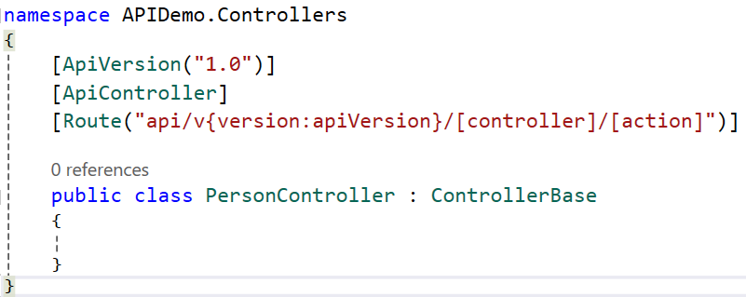
How to do Versioning in .NET Core Web API? Cont..
Add below code at controller level

Slide 10
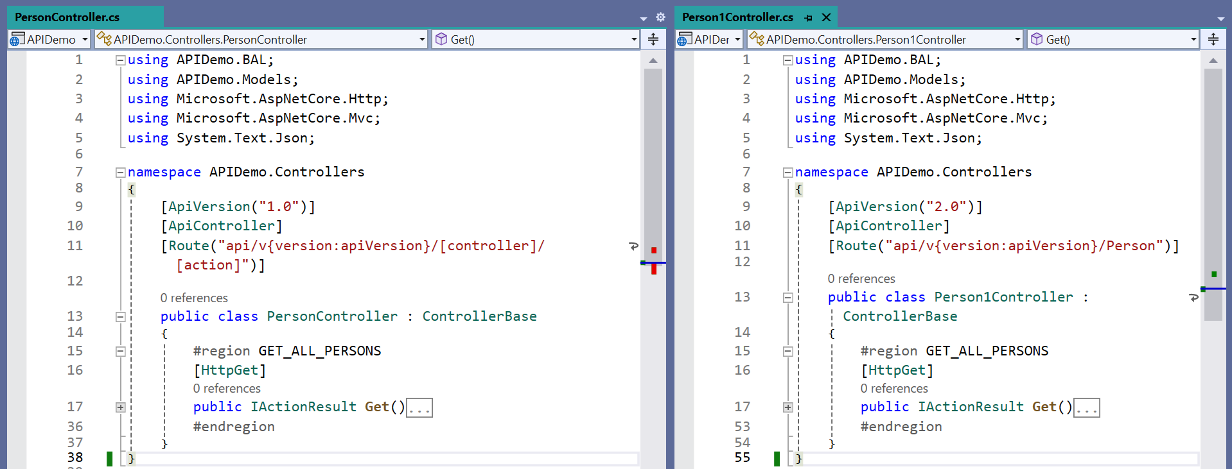
How to do Versioning in .NET Core Web API? Cont..

Slide 11
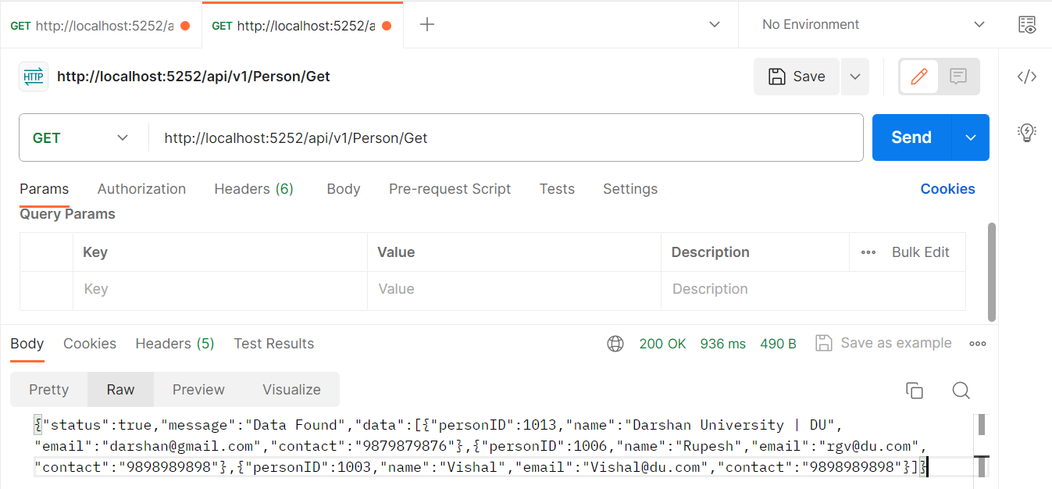
Output-1 : Postman

Slide 12
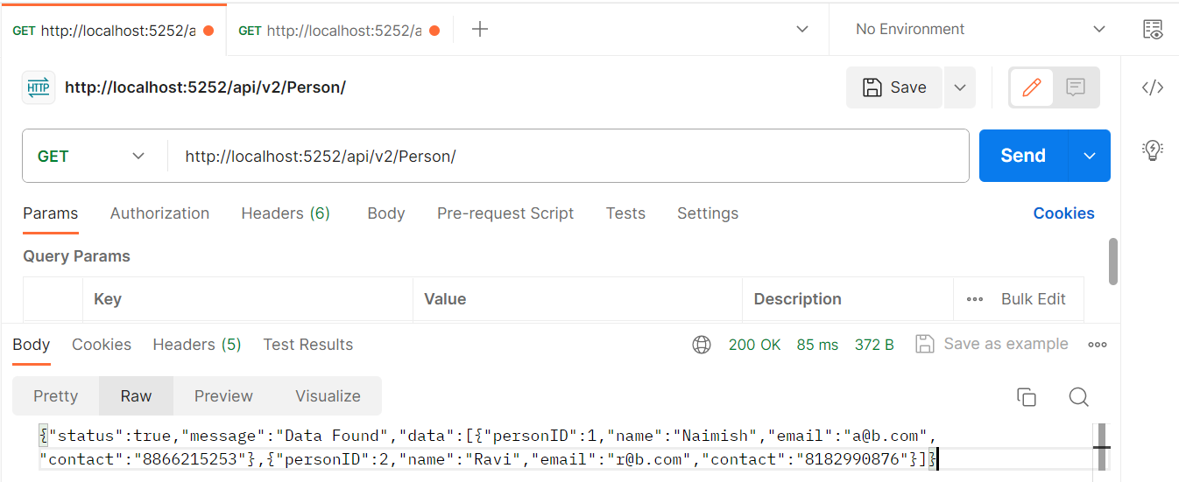
Output-2 : Postman

Slide 13
Attribute Routing
Section – 2

Slide 14
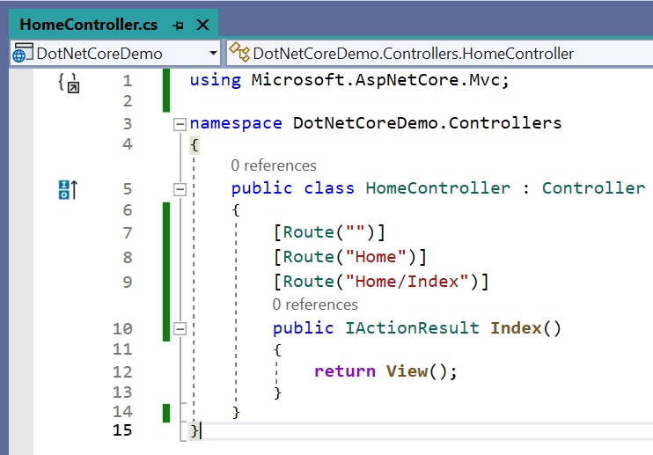
Attribute Routing
With the help of ASP.NET Core Attribute Routing, you can use the Route attribute to define routes for your application.
You can use the Route attribute either at the Controller level or at the Controller Action Methods level.
When you apply the Route attribute at the Controller level, then it is applicable for all the action methods of that controller.
Let us modify the Home Controller as shown here.
Here we have applied the Route Attribute at the Action method.

Slide 15
Attribute Routing Cont..
If you notice, here we applied the Route() attribute 3 times on the Index() action method of Home Controller.
The point that you need to remember is, with each instance of the Route attribute we specified a different route template.
With the above three Route attribute, now we can access the Index() action method of the HomeController using the following 3 URLs.
http://localhost:5280/
http://localhost:5280/Home
http://localhost:5280/Home/Index

Slide 16
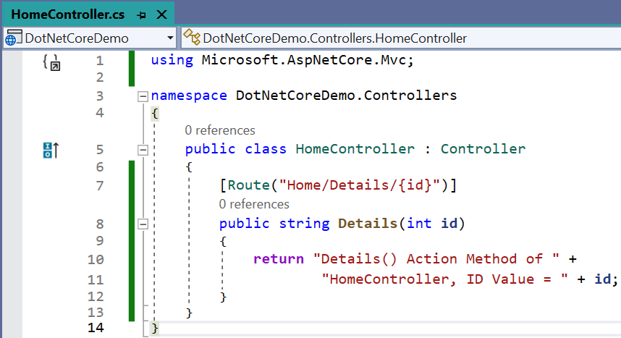
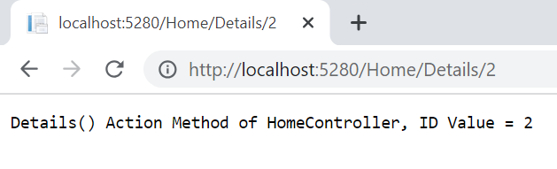
Attribute Routing (With Parameters) Cont..
With conventional based routing, we can specify the route parameters as part of the route template.
We can also do the same with attribute routing. That means we can also define Route Attribute with parameters.
To understand this, modify the Home Controller as shown here.
This is done by a process called Model binding.
Output

Slide 17
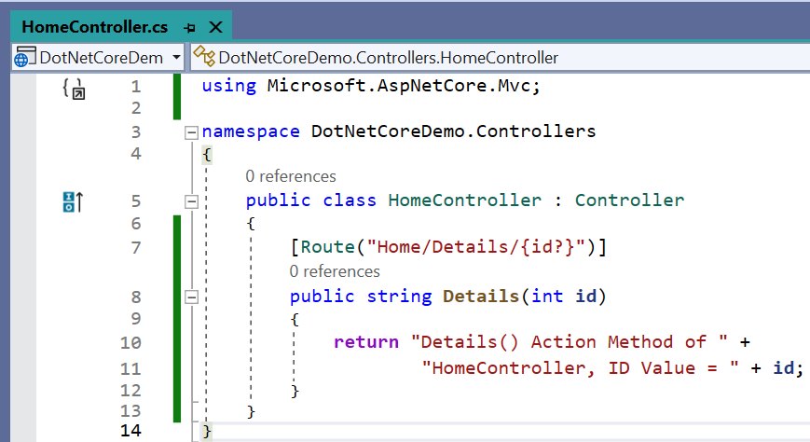
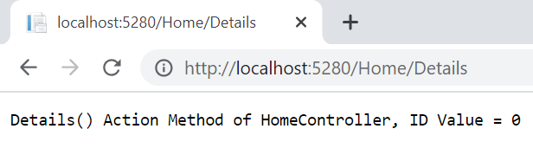
Attribute Routing (With Optional Parameters) Cont..
Like conventional based routing, we can also make a parameter as optional in Attribute Routing.
To make the Route parameter optional, simply add a question mark “?” at the end of the parameter.
Now, we check the output with given images.
Output

Slide 18
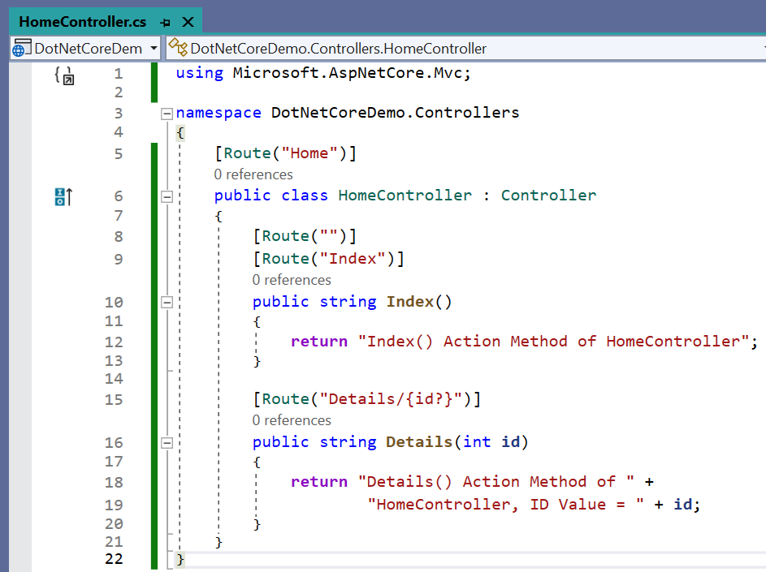
Attribute Routing (At Controller Level) Cont..
In the ASP.NET Core MVC application, it is also possible to apply the Route() attribute on the Controller class as well as on individual action methods.
If you want to make the attribute routing less repetitive, then you need to use the route attributes on the controller level as well as on the individual action methods level.
The Route template applied on the controller level is prepended to the route template applied to the action method level.

Slide 19
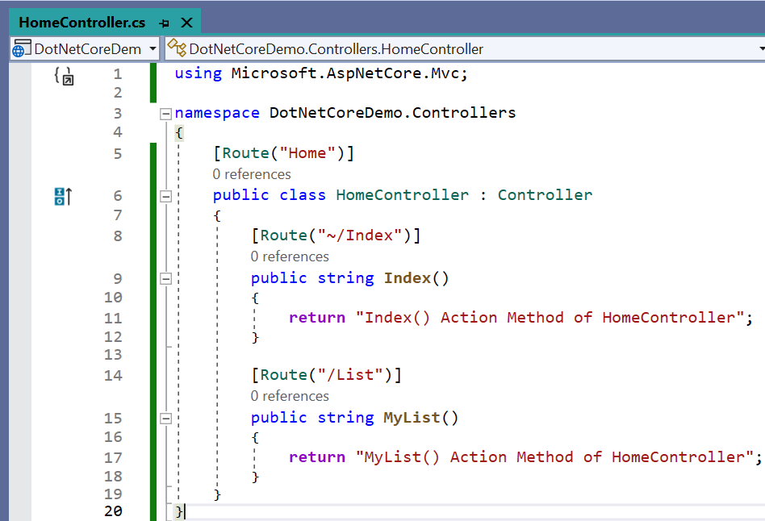
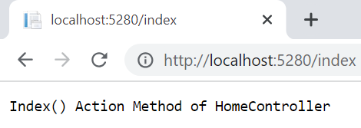
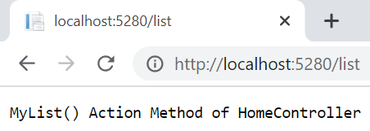
How to ignore the Route Template placed at the Controller Level?
In order to ignore the Route Template placed at the Controller level, you need to use / or ~/ at the action method level.
If the action method route template starts with / or ~/, then the controller route template is not going to be combined with the action method route template.
Output

Slide 20
Routing in Web API
Section - 3

Slide 21
Routing in Web API
Routing in Web API allows users to match the upcoming HTTP requests, after performing the match, the requests are dispatched to the executable endpoints of the application.
Endpoints can be Action Methods [GetAll(), Insert(), Update(), Delete() etc.] also.
These endpoints are configured at the beginning of the application configuration.
The endpoint can be matched by extracting values from the requested URL and retrieving those values to further process ahead.
If the users have the endpoint information from the app through routing they will also generate URLs that would map to endpoints.
Setup for Routing is registered in middleware in Program.cs
UseRouting and UseEndpoints are the two ways to register Routing

Slide 22
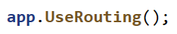
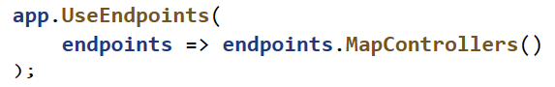
Routing in Web API Cont..
Setup for Routing is registered in middleware in Program.cs
UseRouting and UseEndpoints are the two ways to register Routing..
UseRouting configures the route that matches with the middleware pipeline.
After looking into the set of endpoints specified in the app, the middleware then selects the most appropriate match based on the request called.
UseEndpoints is used to configure the endpoint execution to the middleware pipeline.
It runs the delegate related to the chosen endpoint.

Slide 23
Order Property in Route
There is an internal tree built that continuously matches all the endpoints.
If you use Route then they are configured using Order property.
The route entries are processed in ascending order based on Order property.
In special cases, routes get a chance of execution before the general routes.
[Route("[controller]")]
public class PersonController : ControllerBase
The above code block matches with the “/person” URL

Slide 24
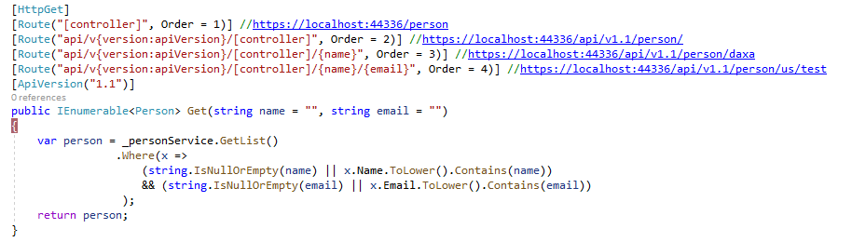
Order Property in Route - Example

Slide 25
Data Annotations
Section - 3

Slide 26
Data Annotations
Data validation is one of the first steps towards cleaning data before you can process and manipulate it.
It ensures that the data is reliable and complies with your organization’s rules.
These rules might include the following:
Restricting a maximum length of a variable or field
Ensuring the correct format of input, such as for emails
Ensuring the user input always contains certain keywords
Client-side validation has superb support and doesn’t need repetition of validation rules.
It’s possible to configure all of the validation rules in one location in the coding and those rules do not have to be used elsewhere.
Testing can be performed on data annotation attributes to ensure their existence.

Slide 27
Data Annotations Cont..
Data annotations in ASP.NET Core are attributes that can be applied to model properties to define validation rules, format strings, and other metadata.
They are a key feature of the .NET framework and can help make your code more efficient, easier to maintain, and more secure.
Namespace for data annotation is System.ComponentModel.DataAnnotations;
There are 3 main areas where you may use it, two of them are related to your data presentation to your end user and one is to design your database.
Front-End: Validation Attributes
Used to enforce validation rules in your view. It can be used to validate email, data, fields with masks, etc.
Front-End: Display Attributes
Used to specify how your properties from your Model will be displayed. It can be used within Resources to display a different value depending on the user language.
Back-End: Modelling Attributes
Used to specify the table limitations and the relationship between classes. It can be used to set field type, mask, etc.

Slide 28
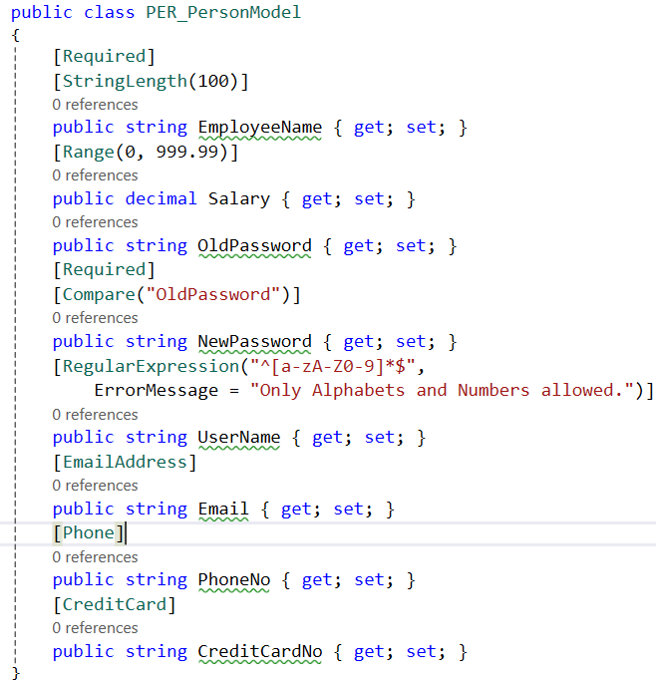
Examples: Data Annotations | Validation Attributes
Front-End: Validation Attributes
Attribute | Description
Required | Validates that an inputted value is not null.
StringLength | Validates that a string property value does not exceed a specified length limit.
Range | Validates that a property value falls within a specified range.
Compare | Validates that two properties in a model to match.
RegularExpression | Validates that a property value matches a specified regular expression.
EmailAddress | This validation attribute validates the email address format.
Phone | This validation attribute validates the phone no format.
CreditCard | This attribute validates a credit card format.

Slide 29
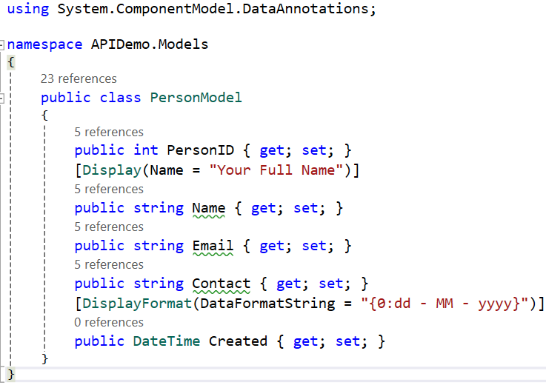
Examples: Data Annotations | Display Attributes
Front-End: Display Attributes
Attribute | Description
Display | Specifies a friendly display name for a property, which is often more readable than the property’s actual name. Example [Display (Name = “Your Full Name")] public string FullName { get; set; }
DisplayFormat | It is particularly useful when controlling data formatting for display purposes or accepting user input. Example [DisplayFormat (DataFormatString = “{0:dd-MM-yyyy}”)] public DateTime BirthDate { get; set; }

Slide 30
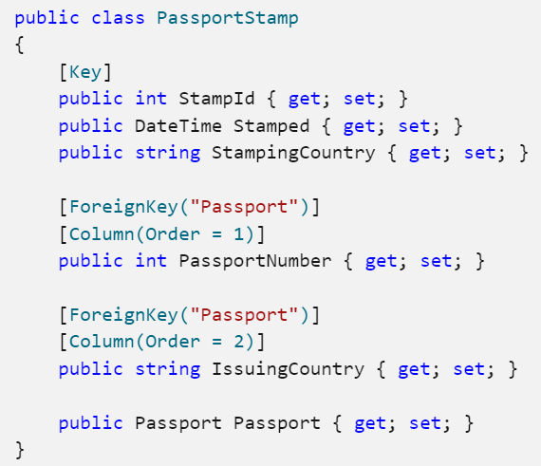
Examples: Data Annotations | Modelling Attributes
Front-End: Modelling Attributes
Attribute | Description
Key | If you are using code first’s database generation feature, the table will have a primary key column, which is also defined as Identity by default.
[ForeignKey (“ColumnName")] | If you want to specify the foreign key in your table, write it with column name.
[Column(Order = 1)] | If you have entities with composite foreign keys, then you must specify the same column ordering that you used for the corresponding primary key properties.

Slide 31
Fluent Validation
Section - 4

Slide 32
When to use Fluent Validation?
Conditional validation is required on multiple properties, when compared to data annotation, it’s much easier to use fluent validation with multiple properties.
View models must be separated from validation models.
Standard validation rules benefit from additional support. Fluent validation has much better client-side support than data annotation.
You need more control over validation rules.
Fluent Validation is a .NET library for building strongly-typed validation rules.
The fact is that both data annotation and fluent validation have their own unique strengths that make them viable under specific scenarios.
Both are superb validation tools for MVC, .NET, and ASP but fluent validation does provide more control over validation rules since it uses more advanced API to solve specific validations.

Slide 33
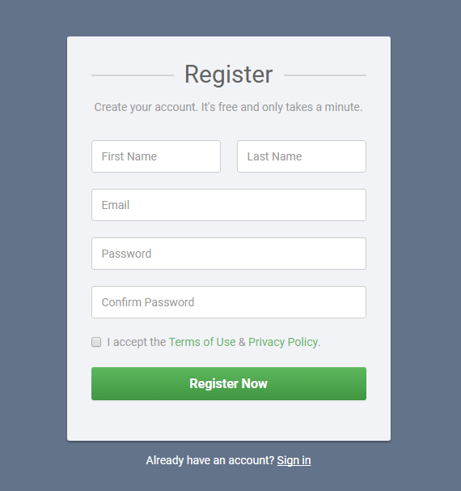
Apply Fluent Validation in Given Register Form

Slide 34
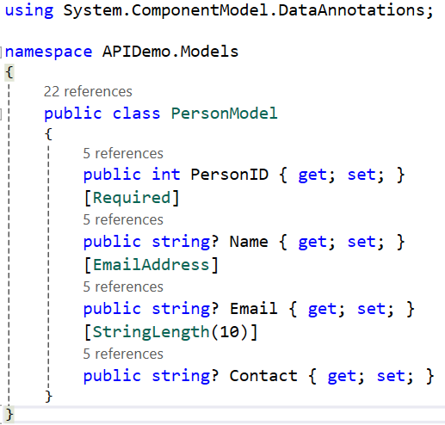


How to Use Fluent Validation in Our Project?
Don’t use Data Annotation over Model Fields
Steps
First install package FluentValidation.AspNetCore
To add a new validator class for separate validation rules of particular model.
Add validation rules in newly created class.
Register services of fluent validation in program.cs
Run the Project & Check in Swagger or form.

Slide 35
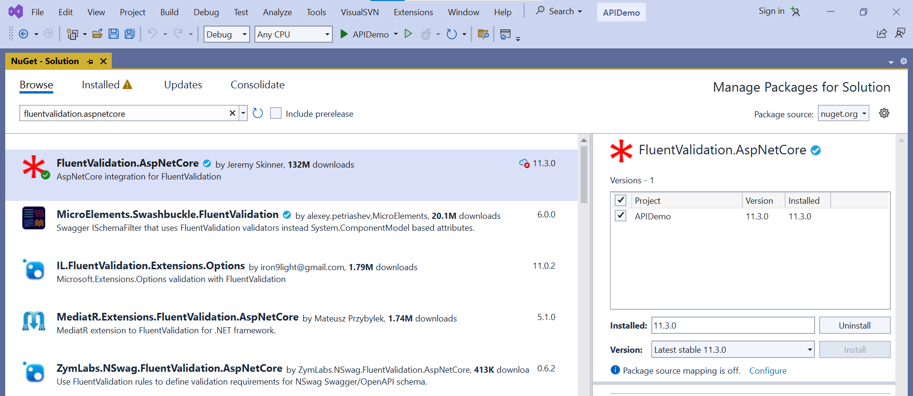
Step – 1 | Install Package FluentValidation.AspNetCore

Slide 36
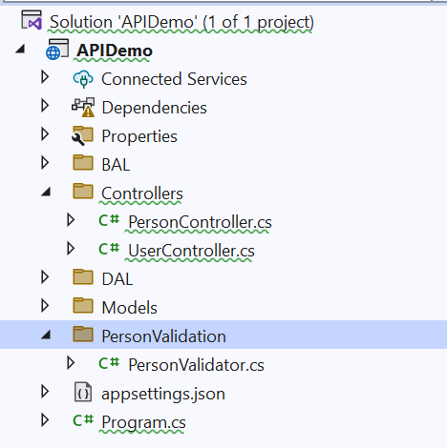
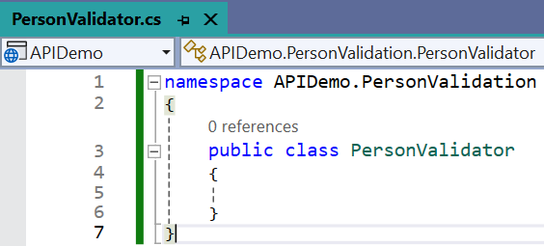
Step – 2 | Add a new validator class for separate validation rules of particular model

Slide 37
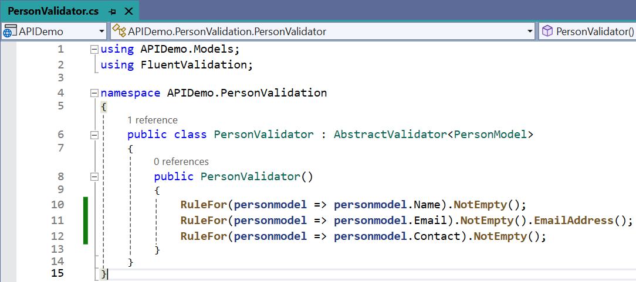
Step – 3 | Add validation rules in newly created class
AbstractValidator<T>:
This is a class provided by FluentValidation.
It is the base class that we need to extend to define our validation rules for a specific model.
In the example, PersonModel is the model being validated.
RuleFor(x => x.PropertyName):
This is the starting method to define a validation rule for a specific property on the model.
It sets the context for further chained methods determining how the property will be validated.

Slide 38
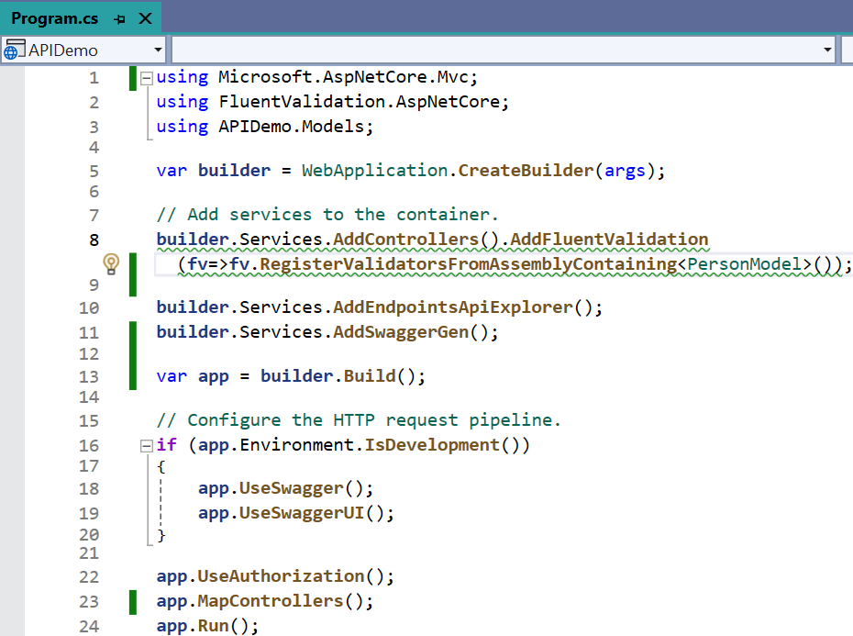
Step – 4 | Register services of fluent validation in program.cs

Slide 39
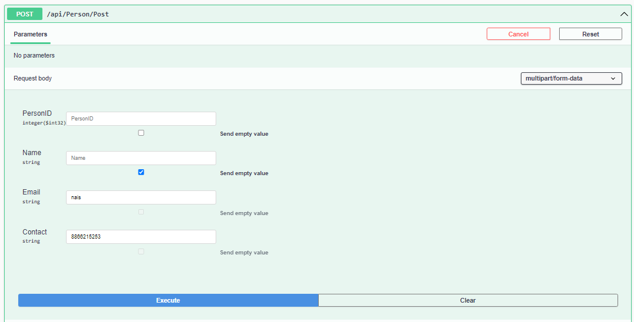
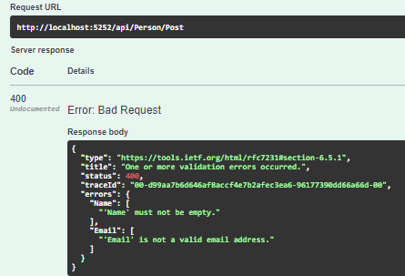
Step – 5 | Run the Project & Check in Swagger or form

Slide 40
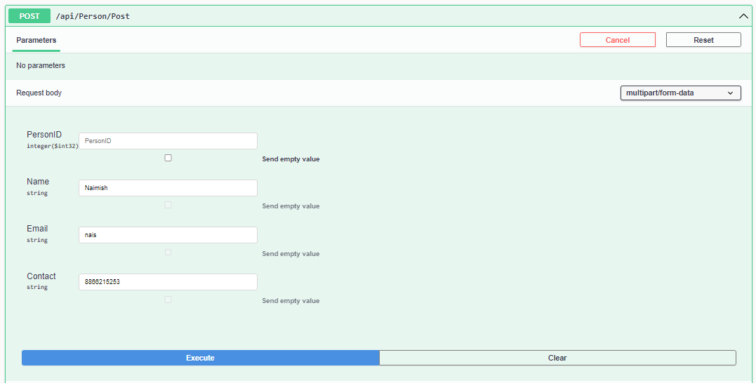
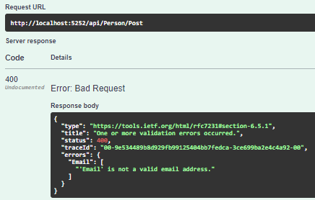
Step – 5 | Run the Project & Check in Swagger or form Cont..

Slide 41
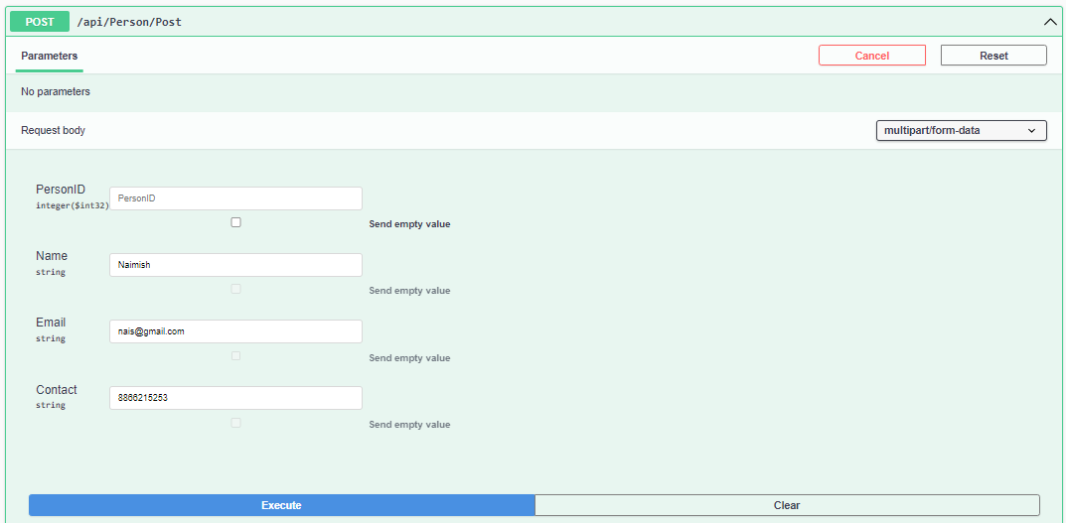
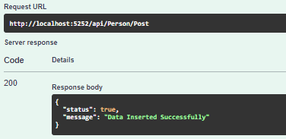

Step – 5 | Run the Project & Check in Swagger or form Cont..

Slide 42
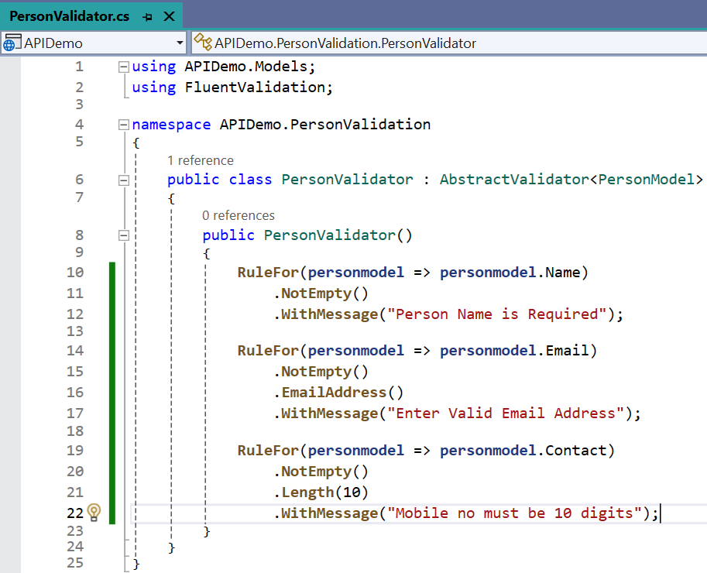
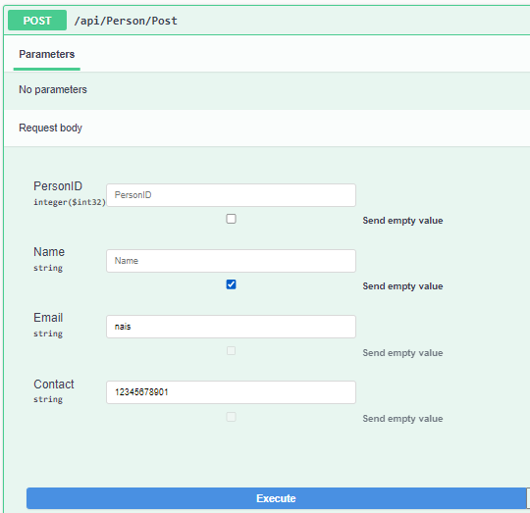
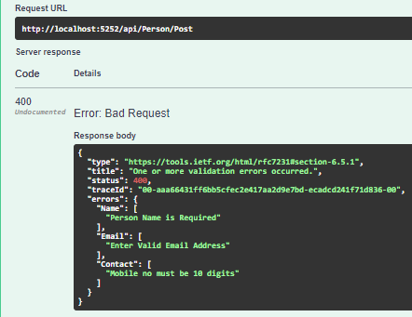
Example - 1

Slide 43
Fluent API Basic Validators
Validator | Description
NotNull() / NotEmpty() | Check the property is not null or empty
Equal() | Checks if the property equals another value or property
NotEqual() | Checks the property is not equal to another value or property
Length() | Checks the length of a string property that falls within the given min and max range
Matches() | Checks the property matches a given regex pattern

Slide 44
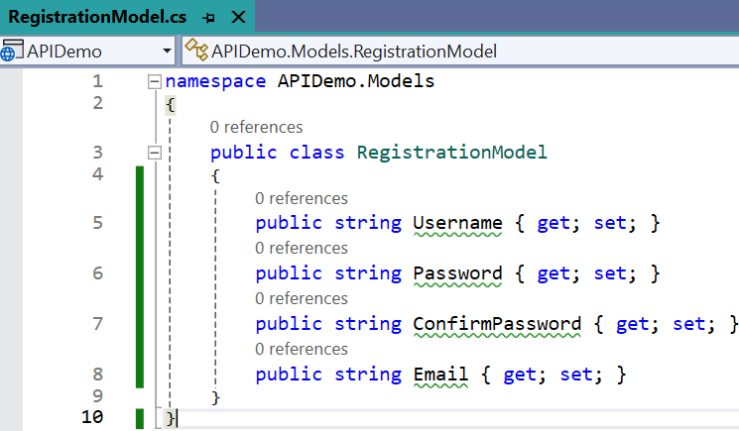
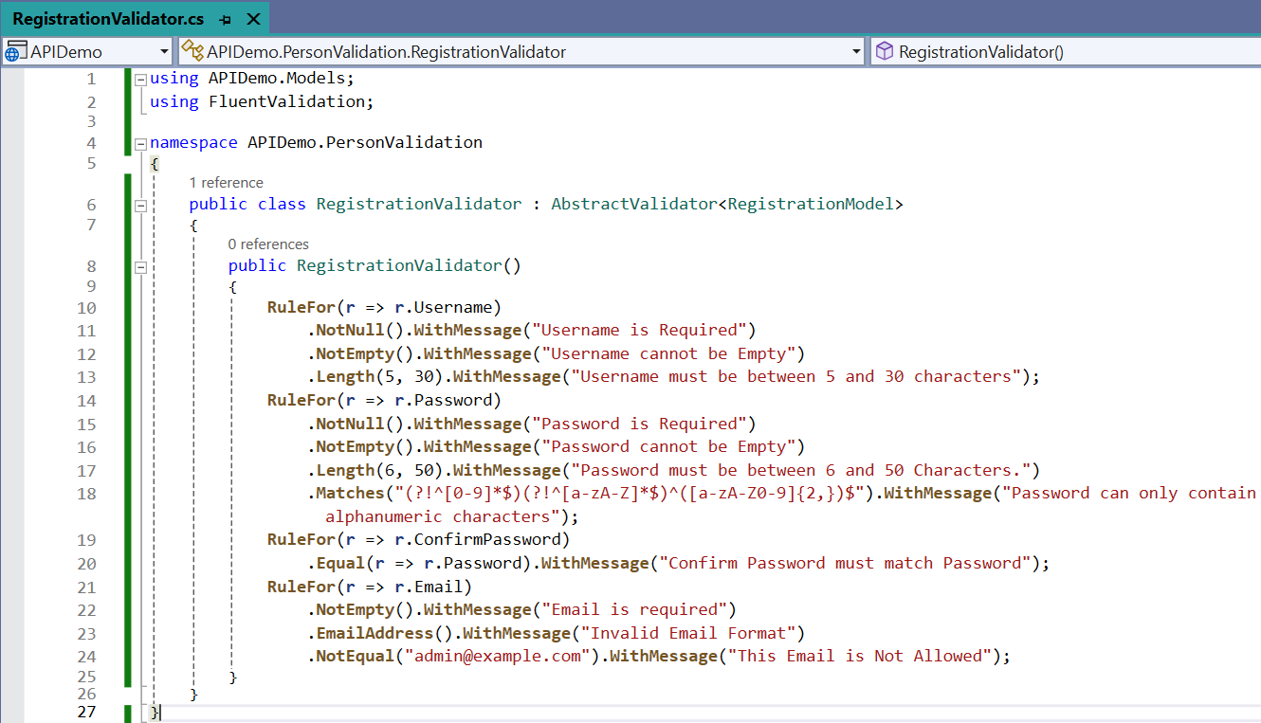
Fluent API Basic Validators Example
Basic Validators
NotNull() / NotEmpty()
Equal()
NotEqual()
Length()
Matches()

Slide 45
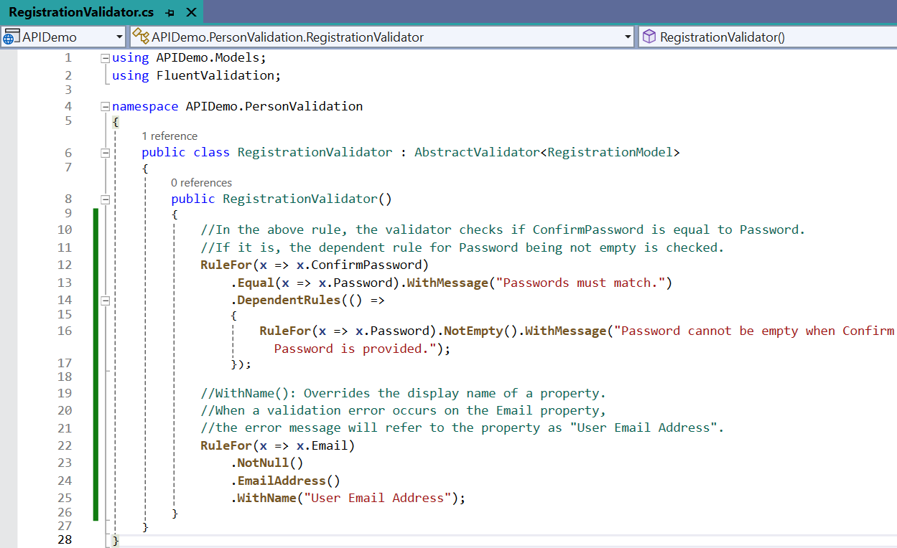
WithName() & Dependent Rules()
Validators
WithName() It is similar to display name in Data Annotations
Dependant Rules()

Slide 46
Fluent API Number Validators
Validator | Description
InclusiveBetween() | Checks the property value falls between or equals to the specified limits InclusiveBetween ensures the value lies within (and including) the provided range
ExclusiveBetween() | Checks the property value falls between but not equal to the specified limits ExclusiveBetween would ensure the value lies within the range but excluding the boundaries
GreaterThan, LessThan, GreaterThanOrEqualTo, and LessThanOrEqualTo set specific bounds on numeric values
LessThan() / LessThanOrEqualTo() | For comparison with another value
GreaterThan() / GreaterThanOrEqualTo() | Comparison with another value, but for greater values.

Slide 47
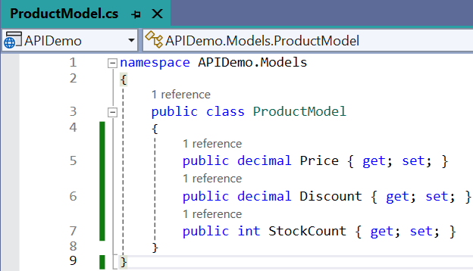
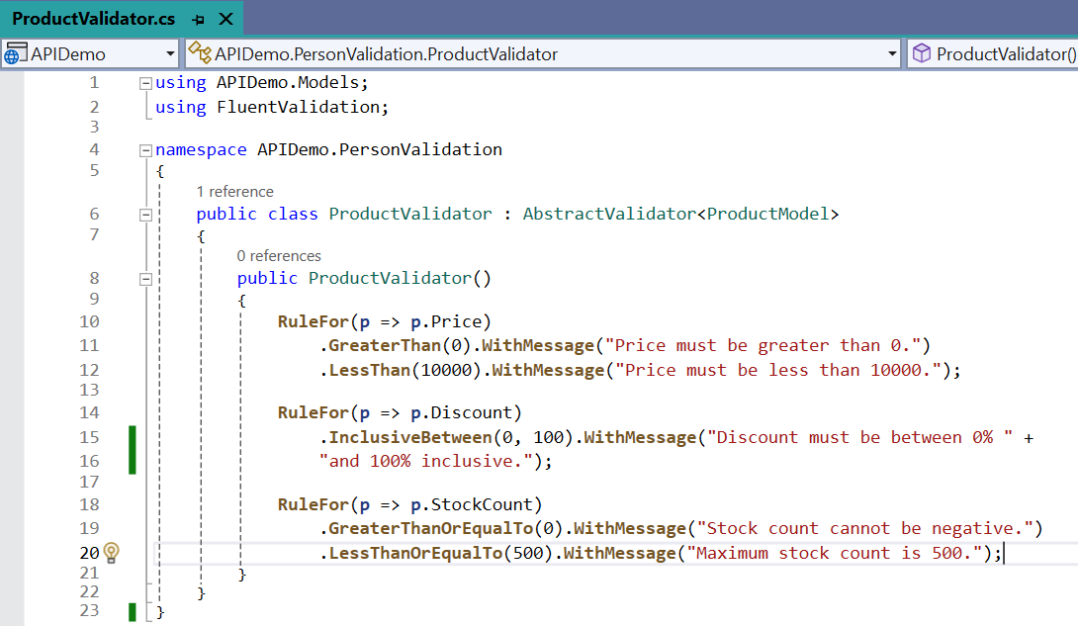
Fluent API Number Validators Example
Number Validators
LessThan() / LessThanOrEqualTo()
GreaterThan() / GreaterThanOrEqualTo()
InclusiveBetween()
ExclusiveBetween()

Slide 48
Fluent String Validators
Validator | Description
EmailAddress() | Ensures that the string is a valid email address format
CreditCard() | Validates the string as a credit card number
PrecisionScale() | Defines a scale precision validator on the current rule builder that ensures a decimal of the specified precision and scale
Matches() | Ensures the property matches a specified regex pattern

Slide 49
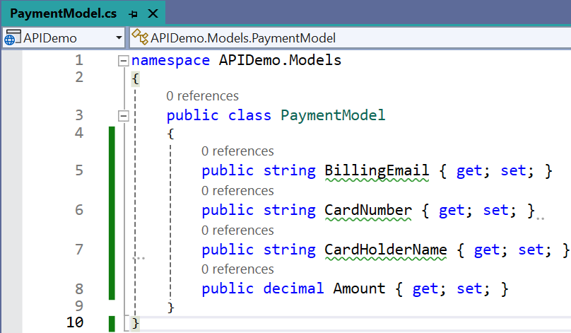
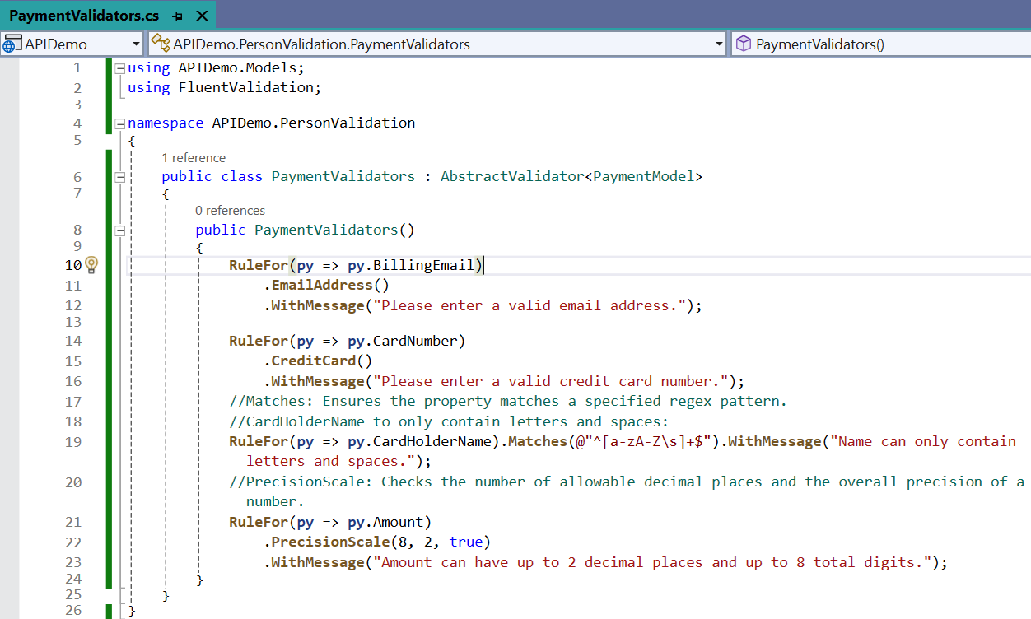
Fluent String Validators Example
String Validators
EmailAddress()
CreditCard()
PrecisionScale()
Matches()

Slide 50
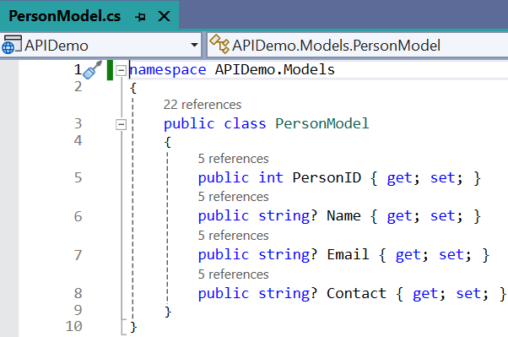
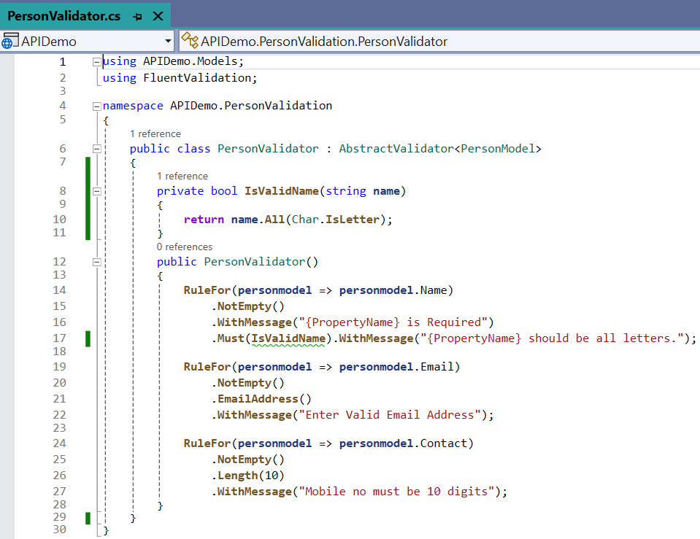
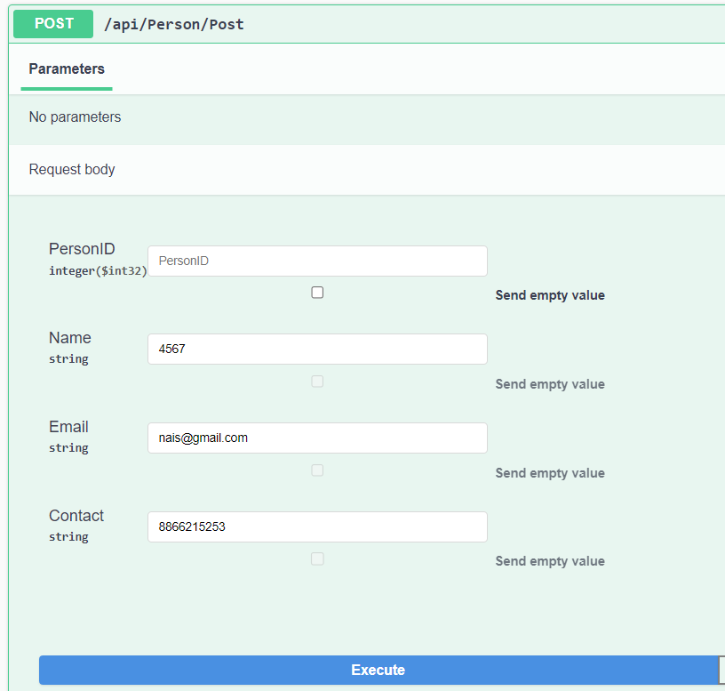
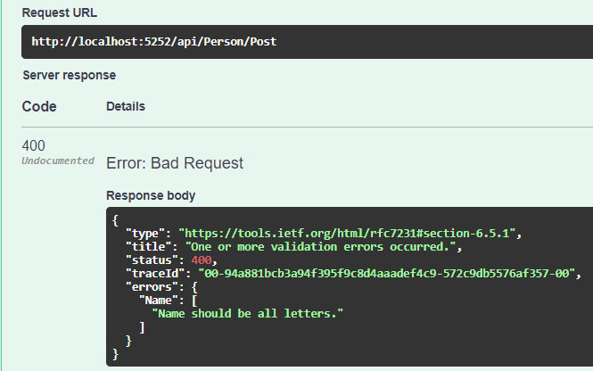
Integrating Custom Functions with Fluent Validation

Slide 51
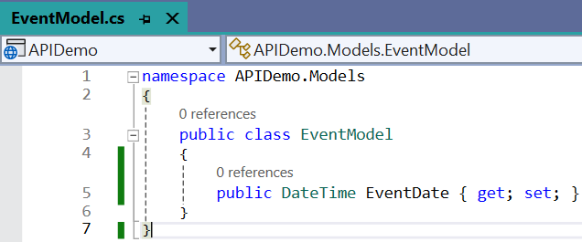
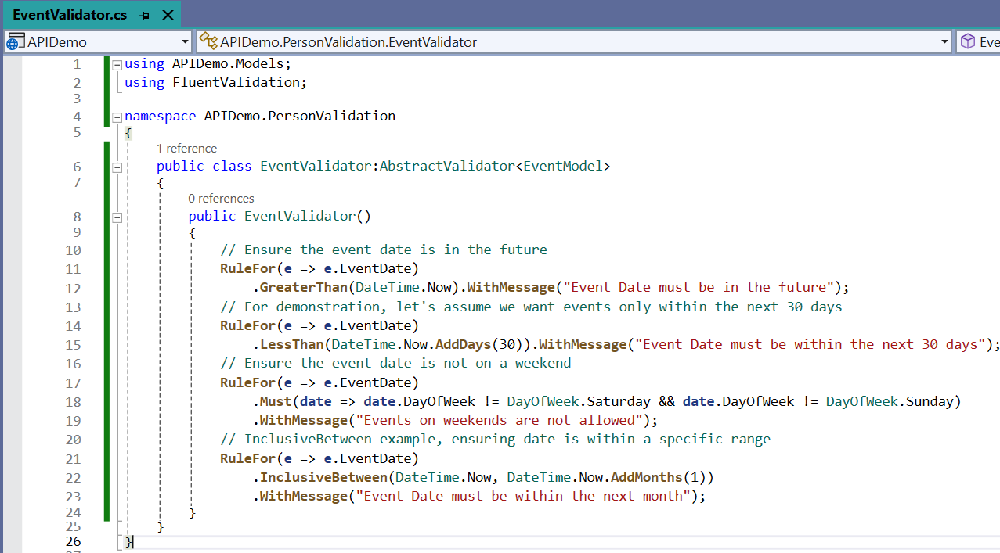
Date Time Validation Example
Rules
EventDate must be future date.
Event date only within the next 30 days.
Eventdate must not be on Saturday & Sunday.
Event Date Must be within the next month.

Slide 52
Conditional Validation using Fluent Validation
Conditional validation is one of the powerful features of Fluent Validation, allowing you to perform validation rules based on certain conditions.
This can be achieved using the following When() and Unless() methods.
They allow you to specify under which conditions a particular validation rule should be executed.
When():
Apply rules conditionally based on properties.
The When method takes an expression or a method which will return a Boolean value.
If the returned value is true, then the immediately preceding validation is applied, otherwise the validation is skipped.
Unless():
The opposite of When(), the rule is applied unless the condition is true.
Similar to When, there is also an Unless method, which takes an expression or a method as input.
That expression or method should return a Boolean Value. If the returned value is false, then the immediately preceding validation is applied, otherwise the validation is skipped.

Slide 53


When() & Unless() Example

Slide 54


ForEach() = Apply a rule to each element in a collection
HashSet
HashSet is an unordered collection of unique elements
It is generally used when we want to prevent duplicate elements from being placed in the collection.
The performance of the HashSet is much better in comparison to the list.

Slide 55

Cascade Modes
The two cascade modes are:
Continue (Default Mode)
Always invokes all rules in a validator class, or all validators in a rule, depending on where it is used.
Stop
Stops executing a validator class as soon as a rule fails, or stops executing a rule as soon as a validator fails, depending on where it is used.

Slide 56
Advantages of Fluent Validation
High Level of Flexibility
Fluent Validation enables you to create any validation rule understandable.
It’s overflowing with power and flexibility.
Testability
Fluent Validation ensures that your code remains test-friendly.
No more struggling unit tests!
Cleaner Code
Say goodbye to cluttered data models.
With Fluent Validation, your validation logic shifts to a separate class, hence code must be clean.
Easy to Maintain
Fluent Validation’s pattern of separating validation rules from business objects makes maintenance a lot easier.
If rules need to change, you know exactly where to look. Plus, it’s easier to reuse validation logic across projects.
Better User Experience:
Fluent Validation allows for easily customizable and detailed error messages that assist users in correcting their data.

Slide 57
Advanced Dot Net
#2101CS611
Prof. Naimish R. Vadodariya
Computer Science & Engineering Department
Naimish.vadodariya@darshan.ac.in
8866215253

